Slide 1
Classification Models
Tomas Karpati tc.datascience@gmail.com
054-2002430

Slide 2
Classification Metrics

Slide 3
Classification Metrics
Accuracy
Precision/Recall
F1 Score
Area Under the Curve (AUC/ROC)
log-loss/binary cross-entropy
R Squared (R²) / Adjusted R Squared (R²)
Information Criteria (AIC, BIC)

Slide 4
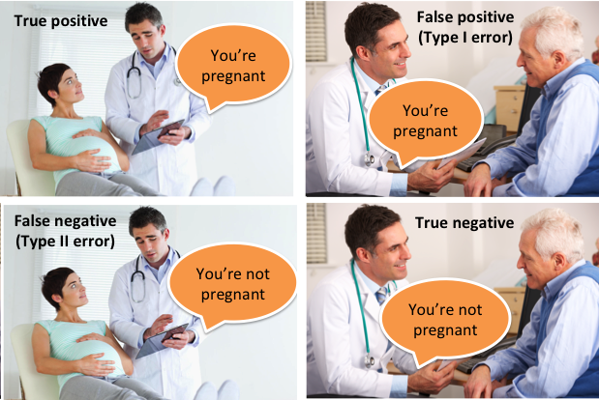
Classification Metrics
Observed Outcome
Yes No
Predicted Outcome
No Yes
Modified from: https://medium.com/@neeraj.kumar.iitg/statistical-performance-measures-12bad66694b7

Slide 5
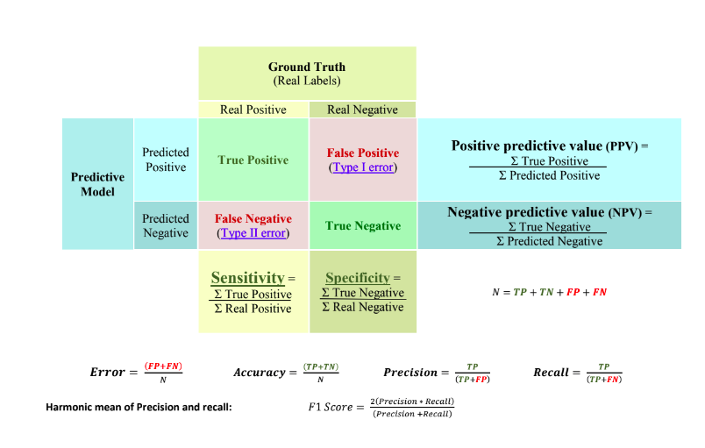
Classification Metrics

Slide 6
Classification Metrics
Accuracy
Accuracy: the rate of correctly predicted outcomes.
Accuracy = (TP + TN) / N
Specificity
Precision
TP | FP
FN | TN
Recall
F1-score

Slide 7
Classification Metrics
Accuracy
Specificity or True Negative Rate (TNR): the proportions of predicted as negative of total negatives
Accuracy = TN / (FP + TN)
Specificity
Precision
TP | FP
FN | TN
Recall
F1-score

Slide 8
Classification Metrics
Accuracy
Precision / Positive predictive value (PPV): the proportions of predicted as positive that are true positive
Precision = TP / (TP + FP)
Specificity
Precision
TP | FP
FN | TN
Recall
F1-score

Slide 9
Classification Metrics
Accuracy
Recall / Sensitivity / True Positive Rate (TPR): is the proportion of actual positives that are correctly identified
Recall = TP / (TP + FN)
Specificity
Precision
TP | FP
FN | TN
Recall
F1-score

Slide 10
Classification Metrics
Accuracy
F1-score: the harmonic mean of precision and recall. Where a value 1 is considered a perfect precision and recall, and 0 is bad.
2(precision*recall)
F1-score =
(precision+recall)
Specificity
Precision
Recall
F1-score

Slide 11
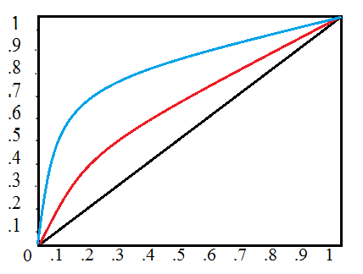
Classification Metrics
Area Under the Curve (AUC) ☞
A statistical metric that indicates the degree of accuracy of a classification model
Indicates the probability that predicting the outcome is better than chance
It is an approximation of the concordance statistic (C-statistic).
Values range from 0.5 to 1.0,
0.5 indicates that the model do not perform better than chance
1.0 indicates that the model perfectly predicts the outcome.

Slide 12
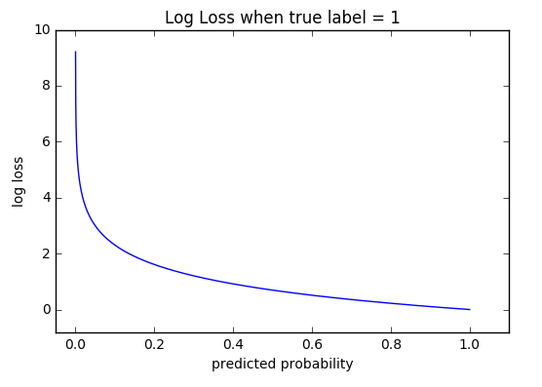
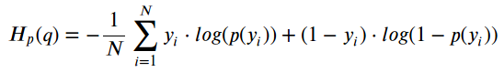
Classification Metrics
Log-loss or binary cross-entropy: a loss function that quantifies the accuracy of the model by penalizing false classifications.

Slide 13
Classification Metrics
Which metric is the best for my classification problem?
Balanced data ⇨ Maximize the true classification
Maximize the true classification: Accuracy / Log-loss
Unbalanced data ⇨ Capture all positives
Minimize false negative: Maximize Recall
⇨ Capture all negatives
Minimize false positives: Maximize Precision
⇨ Balance between Precision and Recall
No need for selecting a cutoff: F1-score
Need to select a cutoff: AUC

